Slide 1
Design Patterns for Lunch Memento
Lars Mudde
27-10-2020

Slide 2
Introduction
Lars Mudde
AMS N21 Software developer
Proud member of DigiD Machtigen team Delorean

Slide 3
Definition
What
Who
Behavioural
Memento
When
How
Creational
Design
patterns
Structural
“Without violating encapsulation, capture and externalize an object’s Internal state so that the object can be restored to this later.”
- Gang of Four
Behavioral
Created by
Noah Thompson David Espiritu Dr. Drew Clinkenbeard

Slide 4


Slide 5
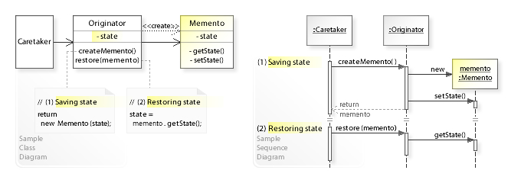
Memento in detail
A way to store previous states of an object easily.
Memento (object): The basic object that is stored in different states.
Originator: Sets and Gets values from the currently targeted Memento. Creates new Mementos and assigns current values to them.
CareTaker (client): Holds an ArrayList that contains all previous versions of the Memento. It can both store and retrieve mementos.
Source Wikipedia

Slide 6
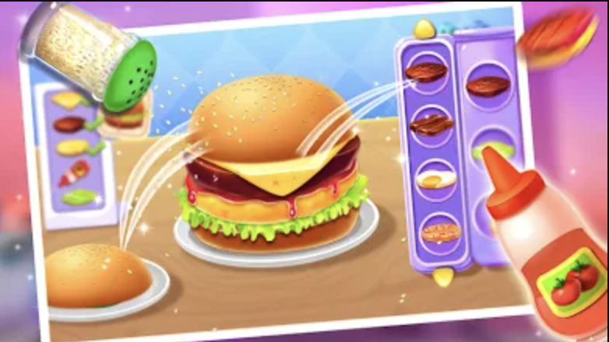
Scenario: Burger Maker, the game.
In Burger Maker you can add different ingredients to your burger and create any burger that you like.
If you decide your combination of ingredients does not work, you can undo your previous steps in order to fix your mistake.
Player adds ingredients.
Player realizes nobody should have pineapple on their burger.
Player can revert the steps one by one in order to fix the mistake.

Slide 7
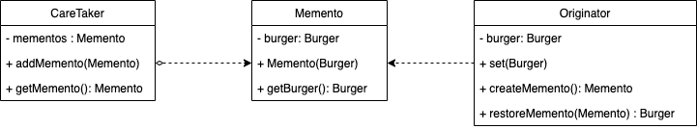
Implementation + Demo
Click here to watch a video of the presentation
Pull the code + Presentation from my GitHub.
https://github.com/LarsMudde/memento

